Slide 1

Fall 2011
Chapter 9
Implementation

Slide 2
Coding
Goal is to implement the design in best possible manner
Coding affects testing and maintenance
As testing and maintenance costs are high, aim of coding activity should be to write code that reduces them
Hence, goal should not be to reduce coding cost, but testing and maintenance cost, i.e. make the job of tester and maintainer easier
Coding

Slide 3
Coding…
Code is read a lot more
  Coders themselves read the code many times for debugging, extending etc
  Maintainers spend a lot of effort reading and understanding code
  Other developers read code when they add to existing code
Hence, code should be written so it is easy to understand and read, not easy to write!
Coding

Slide 4
Coding…
Having clear goal for coding will help achieve them
Weinberg experiment showed that coders achieve the goal they set
  Different coders were given the same problem
  But different objectives were given to different programmers – minimize effort, minimize size, minimize memory, maximize clarity, maximize output clarity
  Final programs for different programmers generally satisfied the criteria given to them
Coding

Slide 5
Programming Principles
The main goal of the programmer is write simple and easy to read programs with few bugs in it
Of course, the programmer has to develop it quickly to keep productivity high
There are various programming principles that can help write code that is easier to understand (and test)
Coding

Slide 6
Common Coding Errors
Memory Leaks
  Memory that is not freed when no longer needed
Freeing an already freed resource
NULL dereferencing
  Trying to access the contents of a location that points to NULL
Lack of unique addresses
  Caused by aliasing
Array index out of bound
Arithmetic exceptions
Off by one
  Starting at 1 when we should start at 0
Enumerated data types
  Cause overflow and underflow
Illegal use of & instead of &&
String handling errors
Buffer overflow
Coding

Slide 7
Programming Principles
Structured programming
Information hiding
Programming practices
Coding standards
Coding

Slide 8
Structured Programming
Structured programming started in the 70s, primarily against indiscriminate use of control constructs like gotos
Goal was to simplify program structure so it is easier to understand programs
Is now well established and followed
Coding

Slide 9
Structured Programming…
A program has a static structure which is the ordering of statements in the code – and this is a linear ordering
A program also has dynamic structure –order in which statements are executed
Both dynamic and static structures are ordering of statements
Correctness of a program must talk about the dynamic structure
Coding

Slide 10
Structured Programming…
To show a program as correct, we must show that its dynamic behavior is as expected
But we must argue about this from the code of the program, i.e. the static structure
  I.e. program behavior arguments are made on the static code
This will become easier if the dynamic and static structures are similar
This is the idea behind structured programming
Coding

Slide 11
Structured Programming…
Goal of structured programming is to write programs whose dynamic structure is same as static
I.e. statements are executed in the same order in which they are present in code
As statements organized linearly, the objective is to develop programs whose control flow is linear
Coding

Slide 12
Structured Programming… single-entry-single-exit
Meaningful programs cannot be written as sequence of simple statements
To achieve the objectives, structured constructs are to be used
These are single-entry-single-exit constructs
With these, execution of the statements can be in the order they appear in code
The dynamic and static order becomes same
Coding

Slide 13
Structured Programming… clear behavior
Each structured construct should also have a clear behavior
Then we can compose behavior of statements to understand behavior of programs
Hence, arbitrary single-entry-single-exit constructs will not help
  Need more than sequence of statements
  Need control structures
It can be shown that a few constructs like while, if, and sequencing suffice for writing any type of program
Coding

Slide 14
Structured Programming… formal verification
Structured Programming was promulgated to help formal verification of programs
Without linear flow, composition is hard and verification difficult
But, Structured Programming also helps simplify the control flow of programs, making them easier to understand
Structured Programming is an accepted and standard practice today – modern languages support it well
Coding

Slide 15
Information Hiding
Software solutions always contain data structures that hold information
Programs work on these data structures to perform the functions they want
In general only some operations are performed on the information, i.e. the data is manipulated in a few ways only
E.g. on a bank’s ledger, only debit, credit, check current balance etc. are done
Coding

Slide 16
Information Hiding… only expose operations on data
Information hiding – the information should be hidden; only operations on it should be exposed
I.e. data structures are hidden behind the access functions, which can be used by programs
Information hiding reduces coupling
This practice is a key foundation of OO and components, and is also widely used today
Coding

Slide 17
Some Programming Practices
Control constructs: Use only a few structured constructs (rather than using a large number of constructs)
Goto: Use them sparingly, and only when the alternatives are worse
Information hiding: Use information hiding
Use-defined types: use these to make the programs easier to read
Coding

Slide 18
Some Programming Practices..
Nesting: Avoid heavy nesting of if-then-else
  Easier to do if conditions are disjoint
Module size: Should not be too large – generally means low cohesion
Module interface: make it simple
Robustness: Handle exceptional situations
Side effects: Avoid them, document when exist
  Use of global variables, etc.
Switch case with default
Coding

Slide 19
Some Programming Practices..
Empty catch block: always have some default action rather than empty
Empty if, while: bad practice
Read return: should be checked for robustness
Return from finally: should not return from finally
Correlated parameters: Should check for compatibility
  Parameter needs to match the operation
Coding

Slide 20
Coding Standards
Programmers spend more time reading code than writing code
They read their own code as well as other programmers code
Readability is enhanced if some coding conventions are followed by all
Coding standards provide these guidelines for programmers
Generally are regarding naming, file organization, statements/declarations, …
Some Java conventions discussed here
Coding

Slide 21
Coding Standards…
Naming conventions
  Package name should be in lower case
    mypackage, edu.iitk.maths
  Type names should be nouns and start with uppercase
    Day, DateOfBirth, EventHandler
  Variable names should be nouns in lowercase
    name, amount
  Variables with large scope should have long names; variables with small scope short names
  Loop iterators should be i, j, k…
  Constant names should be all uppercase
    PI, MAX_INTERACTIONS
  Method names should be verbs starting with lower case
    getValue()
Coding

Slide 22
Coding Standards…
Naming conventions…
  Private class variables should have the _ suffix
    private int value_
  Prefix is should be used for Boolean methods
    isStatus,
  Avoid negative Boolean variable names
    isNotCorrect
  Use term compute for methods that computes something
    computeMean()
  Use term find for methods that looks up something
    findMin()
  Exception classes should be suffixed with Exception
    OutOfBoundException
Coding

Slide 23
Coding Standards…
Files
  Source files should have .java extension
  Each file should contain one outer class and the name should be same as file
  Line length should be less than 80
    If longer continue on another line
  Special characters should be avoided
Coding

Slide 24
Coding Standards…
Statements
  Variables should be initialized where declared in the smallest possible scope
  Declare related variables together; unrelated variables should be declared separately
  Class variables should never be declared public
  Loop variables should be initialized just before the loop
  Avoid using break and continue in loops
  Avoid executable statements in conditionals
  Avoid using the do… while construct
  Avoid complex conditional expressions
    Introduce temporary Boolean variables instead
  Avoid executable statements in conditionals
Coding

Slide 25
Coding Standards…
Commenting and layout
  Single line comments for a block should be aligned with the code block
  There should be comments for all major variables explaining what they represent
  A comment block should start with a line with just /* and end with a line with */
  Trailing comments after statements should be short and on the same line and shifted far enough to separate them from statements
Coding

Slide 26
Coding Process
Coding starts when specifications for modules from design is available
Usually modules are assigned to programmers for coding
In top-down development, top level modules are developed first; in bottom-up lower level modules
For coding, developers use different processes; we discuss some here
Coding

Slide 27
An Incremental Coding Process
Basic process: Write code for the module, unit test it, fix the bugs
It is better to do this incrementally – write code for part of functionality, then test it and fix it, then proceed
I.e. code is built for a module incrementally
Coding

Slide 28
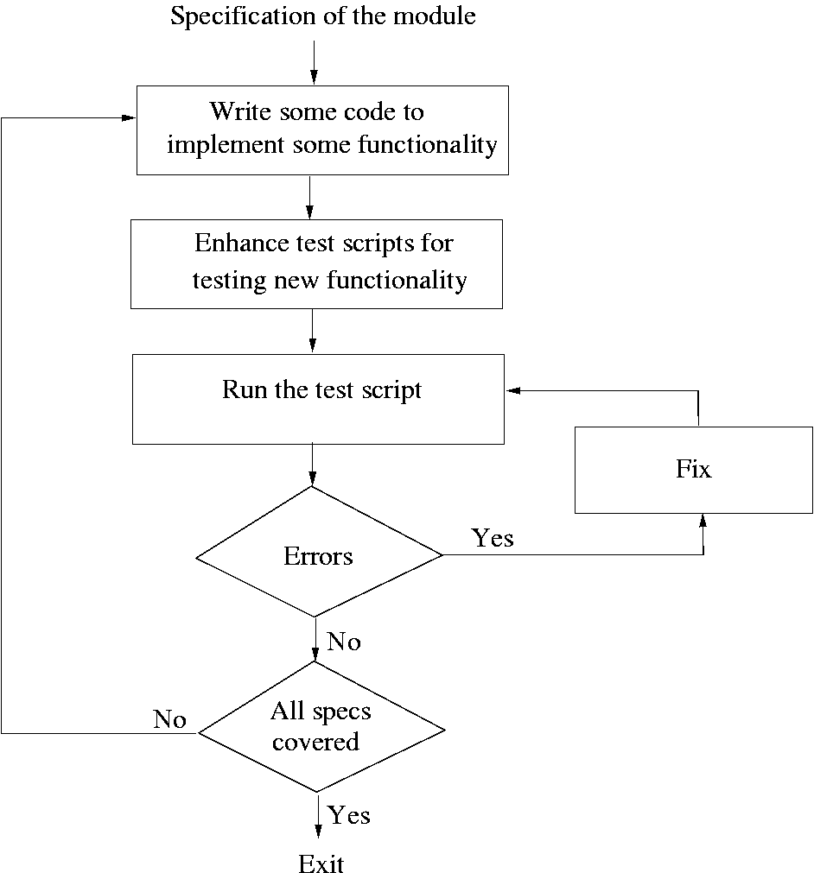
Coding

Slide 29
Test Driven Development
This coding process changes the order of activities in coding
In TDD, programmer first writes the test scripts and then writes the code to pass the test cases in the script
This is done incrementally
Is a relatively new approach, and is a part of the extreme programming (XP) approach
Coding

Slide 30
TDD…
In TDD, you write just enough code to pass the test
I.e. code is always in sync with the tests and gets tested by the test cases
  Not true in code first approach, as test cases may only test part of functionality
Responsibility to ensure that all functionality is there is on test case design, not coding
Help ensure that all code is testable
Coding

Slide 31
TDD…
Focus shifts to how code will be used as test cases are written first
  Helps validate user interfaces specified in the design
  Focuses on usage of code
Functionality prioritization happens naturally
Has possibility that special cases for which test cases are not possible get left out
Code improvement through refactoring will be needed to avoid getting a messy code
Coding

Slide 32
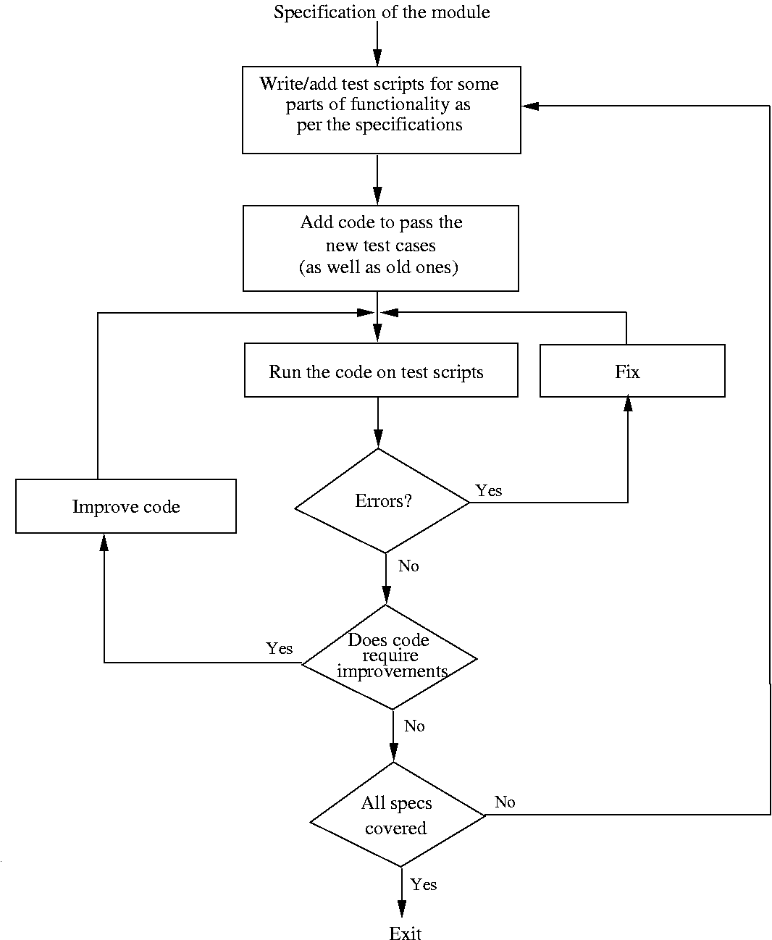
Coding

Slide 33
Pair Programming
Also a coding process that has been proposed as key practice in XP
Code is written by pair of programmers rather than individuals
  The pair together design algorithms, data structures, strategies, etc.
  One person types the code, the other actively reviews what is being typed
  Errors are pointed out and together solutions are formulated
  Roles are reversed periodically
Coding

Slide 34
Pair Programming…
PP has continuous code review, and reviews are known to be effective
Better designs of algorithims/DS/logic/…
Special conditions are likely to be dealt with better and not forgotten
It may, however, result in loss of productivity
Ownership and accountability issues are also there
Effectiveness is not yet fully known
Coding

Slide 35
Source Code Control and Built
Source code control is an essential step programmers have to do
Generally tools like Concurrent Versioning System (CVS), Visual SourceSafe (VSS) are used
A tool consists of repository, which is a controlled directory structure
The repository is the official source for all the code files
System build is done from the files in the repository only
Tool typically provides many commands to programmers
Coding

Slide 36
Source code control…
Checkout a file: by this a programmer gets a local copy that can be modified
Check in a file: changed files are uploaded in the repository and change is then available to all
Tools maintain complete change history and all older versions can be recovered
Source code control is an essential tool for developing large projects and for coordination
Coding

Slide 37
Verification
Code has to be verified before it can be used by others
Here we discuss only verification of code written by a programmer (system verification is discussed in testing)
There are many different techniques; key ones – unit testing, inspection, and program checking
Program checking can also be used at the system level
Coding

Slide 38
Code Inspections
The inspection process can be applied to code with great effectiveness
Inspections held when code has compiled and a few tests passed
Usually static tools are also applied before inspections
Inspection team focuses on finding defects and bugs in code
Checklists are generally used to focus the attention on defects
Coding

Slide 39
Code Inspections…
Some items in a checklist
  Do data definitions exploit the typing capabilities of the language
  Do all pointers point to something
    Any dangling pointers
    Checked for NULL when being used
  Are all vars and pointers initialized
  Are all array indexes within bounds
  Will all loops always terminate
    Are loop termination conditions correct
    Is number of loop iterations off by one
Coding

Slide 40
Code Inspections…
Some items in a checklist…
  Are divisors checked for zero
  Do actual and formal parameters match
  Are all variables used
    Are all output variables assigned
  Can statements placed in loop be placed outside loop
  Are the labels unreferenced
  Any security flaws
  Is input data being checked
  Are the local coding standards met
Coding

Slide 41
Code inspections…
Are very effective and are widely used in industry (many require all critical code segments to be inspected)
Is also expensive; for non critical code one person inspection may be used
Code reading is self inspection
  A structured approach
  Is also very effective
Coding

Slide 42
Unit Testing
Is testing, except the focus is the module a programmer has written
Most often UT is done by the actual programmer
Unit Testing will require test cases for the module – will discuss in testing
Unit Testing also requires drivers to be written to actually execute the module with test cases
Besides the driver and test cases, tester needs to know the correct outcome as well
Coding

Slide 43
Unit Testing…
If incremental coding is being done, then complete Unit Testing needs to be automated
Otherwise, repeatedly doing Unit Testing will not be possible
There are tools available to help
  They provide the drivers
  Test cases are programmed, with outcomes being checked in them
  I.e. Unit Testing is a script that returns pass/fail
Coding

Slide 44
Unit Testing…
There are frameworks like Junit that can be used for testing Java classes
Each test case is a method which ends with some assertions
If assertions hold, the test case pass, otherwise it fails
Complete execution and evaluation of the test cases is automated
For enhancing the test script, additional test cases can be added easily
Coding

Slide 45
Static Analysis
These are tools to analyze program sources and check for problems
Static analyzer cannot find all bugs and often cannot be sure of the bugs it finds as it is not executing the code
So there is noise in their output
Many different tools available that use different techniques
They are effective in finding bugs like memory leak, dead code, dangling pointers,..
Examples
  Assignments that were never read
  Dead code
  Conditional branches that were never taken
Coding

Slide 46
Formal Verification
These approaches aim to prove the correctness of the program
I.e. the program implements its specifications
Require formal specifications for the program, as well as rules to interpret the program
Was an active area of research; scalability issues became the bottleneck
Used mostly in very critical situations, as an additional approach
Coding

Slide 47
Metrics for Size
LOC or KLOC
  non-commented, non blank lines is a standard definition
  Generally only new or modified lines are counted
  Used heavily, though has shortcomings
Coding

Slide 48
Metrics for Size…
Halstead’s Volume
  n1: no of distinct operators
  n2: no of distinct operands
  N1: total occurrences of operators
  N2: Total occurrences of operands
  Vocabulary, n = n1 + n2
  Log₂(n) is the number of bits needed to represent every element in the program uniquely
  Length, N = N1 + N2
    N is the total occurrences of the different elements
  Volume, V = N log₂(n)
    V is minimum number of bits necessary to represent the program
Coding

Slide 49
Metrics for Complexity
Cyclomatic Complexity is perhaps the most widely used measure
Represents the program by its control flow graph with e edges, n nodes, and p parts
Cyclomatic complexity is defined as V(G) = e-n+p
This is same as the number of linearly independent cycles in the graph
And is same as the number of decisions (conditionals) in the program plus one
Coding

Slide 50
Cyclomatic complexity example…
{
i=1;
while (i<=n) {
J=1;
while(j <= i) {
If (A[i]<A[j])
Swap(A[i], A[j]);
J=j+1;}
i = i+1;}
}
Coding

Slide 51
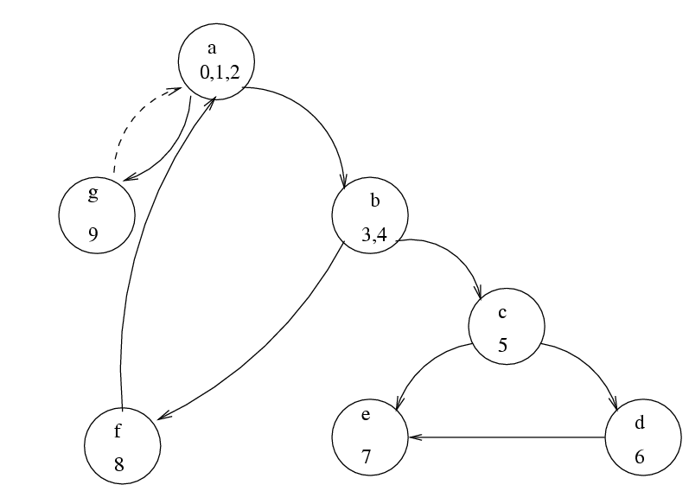
Example…
Coding

Slide 52
Example…
V(G) = 10-7+1 = 4
Independent circuits
  b c e b
  b c d e b
  a b f a
  a g a
No of decisions is 3 (while, while, if); complexity is 3+1 = 4
Coding

Slide 53
Complexity metrics…
Halsteads
  N2/n2 is average times an operand is used
  If variables are changed frequently, this is larger
  Ease of reading or writing is defined as
  D = (n1*N2)/(2*n2)
There are others, e.g. live variables, knot count..
Coding

Slide 54
Complexity metrics…
The basic use of these is to reduce the complexity of modules
One suggestion is that cyclomatic complexity should be less than 10
Another use is to identify high complexity modules and then see if their logic can be simplified
Coding

Slide 55
Summary
Goal of coding is to convert a design into easy to read code with few bugs
Good programming practices like structured programming, information hiding, etc can help
There are many methods to verify the code of a module – unit testing and inspections are most commonly used
Size and complexity measures are defined and often used; common ones are LOC and cyclomatic complexity
Coding

Slide 56
Some Other Topics Related to Coding
Coding

Slide 57
Common Coding Errors
Coding

Slide 58
Common Coding Errors
Goal of programmer is to write quality code with few bugs in it
Much of effort in developing software goes in identifying and removing bugs
Common bugs which occur during coding directly or indirectly manifest themselves to a larger damage to the running program
List of common coding errors can help a programmer avoid them
Coding

Slide 59
Memory Leaks
A memory leak is a situation, where the memory is allocated to the program which is not freed subsequently
Occurs frequently in the languages which do not have automatic garbage collection
Can cause increasing usage of memory which at some point of time can lead to exceptional halt of the program
E.g char* foo(int s)
  {
    Char *output;
    If(s>0)
      Output=(char*) malloc (size)
    If(s==1)
      Return NULL /* if s==1 then mem leaked */
    Return (output);
  }
Coding

Slide 60
Freeing an Already Freed Resource
Programmer tries to free the already freed resource
May be serious, if some malloc between the two free stmts as the freed location may get allocated to a new variable, and subsequent free will deallocate the new variable.
E.g main()
{
char *str;
      Str=(char *)malloc(10);
      If(global==0)
        free(str);
      Free(str); /* str is already freed */
    }
Coding

Slide 61
NULL Dereferencing
Occurs when we access a location that points to NULL
Improper initialization and missing the initialization in different paths leads to the NULL reference error
Can also be caused by aliases- for e.g two variables refer to same object , and one is freed and an attempt is made to dereference the second
E.g char *ch=NULL;
  if (x>0)
  {
    ch=‘c’;
  }
  printf(“\%c”. *ch); /* ch may be NULL */
  *ch=malloc(size)
  ch=‘c’; /* ch will be NULL if malloc returns NULL */
Coding

Slide 62
NULL Dereferencing (accessing uninitialized memory)
NULL dereference is the error of accessing initialized memory
Often occurs if data is initialized in most cases, but most cases do not get covered
  E.g switch(i)
  {
    case 0: s=OBJECT_1; break;
    case 1: s=OBJECT_2; break;
  }
  return (s); /* s not initialized for values other than 0 or 1 */
Coding

Slide 63
Lack of Unique Addresses
Aliasing creates many problems among them is violation of unique addresses when we expect different addresses.
e.g in the string concatenation function, we expect source and destination addresses to be different.
strcat (src , destn );
/* In above function , if src is aliased to destn , then we may get a runtime error */
Coding

Slide 64
Synchronization Errors
Possible when there are multiple threads which are accessing some common resources, in a parallel program
three categories of synchronization errors: deadlocks, race condition, live lock
Deadlock example:
    Thread 1:
    synchronized (A){
    synchronized (B){ }
    }
    Thread 2:
    synchronized (B){
    synchronized (C){ }
    }
    Thread 3:
    synchronized (C){
    synchronized (A){ }
    }
Coding

Slide 65
Synchronization Errors…
Race condition occurs when two threads access same resource and result depends on the order of the execution
E.g class reservation
    {
    int seats_remaining ;
    public int reserve (int x)
    {
    if (x <= seats_remaining ) {
    seats_remaining -=x;
    return 1;
    }
    return 0;
    }
    }
Inconsistent synchronization represents the situation where there is a mix of locked and unlocked accesses to some shared variables, pariticularly if the access involves updates
Coding

Slide 66
Buffer overflow
It is a security vulnerability, can be exploited by executing arbitrary code by a malicious user
E.g
      char s1 [1024];
      void mygets ( char *str ){
      int ch;
      while (ch= getchar () != ‘\n’ && ch != ‘\0 ’)
      *( str ++)= ch;
      *str = ‘\0 ’;
      }
      main (){
      char s2 [4];
      mygets (s2 );
      }
If we have malicious code in s1 and if return address of mygets() is replaced by this address by overflowing the buffer s2, then we can have the code in s1 executed
Coding

Slide 67
Other common type of errors
Array index out of bounds, care needs to be taken to see that the array index values are not negative and do not exceed their bounds
Enumerated data types can lead to overflow and underflow errors, care should be taken while assuming the values of such types
    typedef enum {A, B,C, D} grade ;
    void foo( grade x){
    int l,m;
    l= GLOBAL_ARRAY [x -1];
    /* Underflow when A */
    m= GLOBAL_ARRAY [x +1];
    /* Overflow when D and size of array is 4 */
    }
Coding

Slide 68
Other common type of errors..
Arithmetic exceptions, include errors like divide by zero and floating point exceptions
Off by one errors like starting variable at 1 instead of starting at 0 or vice versa, writing <= N instead of < N or vice versa etc.
String handling errors like failure of string handling functions e.g strcpy, sprintf, gets etc.
Illegal use of & instead of &&, arises if non short circuit logic (like & or |) is used instead of short circuit logic (&& or ||)
E.g if(object!null &object.getTitle()!=null)
  /* Here second operation can cause a null dereference */
Coding

Slide 69
Proving Correctness
Coding

Slide 70
Background
Ultimate goal of verification techniques is to make programs correct by removing errors
Proving a program as correct while developing it may result in more reliable program that can be proved more easily
Any proof technique must begin with a formal specification of the program
Stating the goal of the program is not sufficient
Input conditions in which the program is to be invoked (pre conditions) and expected valid results (post conditions) should also be mentioned.
Coding

Slide 71
Axiomatic Approach
Axiomatic method (Floyd-Hoare proof method) is one method for proving correctness
Goal is to take the program and construct a sequence of assertions, and the rules and axioms about statements and operations in the program
Basic assertion about a program in Hoare’s notation
  P{S}Q
  P – precondition, Q – post condition,
  S- program segment
These assertions are about the values taken by the variables in the program before and after its execution
Coding

Slide 72
Axiomatic approach…
Some rules and axioms are necessary in order to prove the theorem of the form P{S}Q
Let us consider a simple programming language which deals with integers and has types of statements 1) assignment 2) conditional 3)iterative statement
Coding

Slide 73
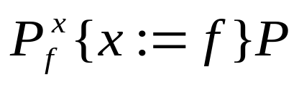

Axiom of Assignment
Consider an assignment statement of the form x:=f where x is an identifier, f is an expression without any side affects
Any assertion that is true about x after the assignment must be true of the expression f before the assignment
The axiom is stated as
P is the post condition of the program segment containing only the assignment statement
is an assertion obtained by substituting f for all occurrences of x in the assertion P.
Coding

Slide 74
Rule of composition
Rule for sequential composition where two statements S1 and S2 are executed in sequence
P {S1 }Q,Q {S2 }R
P{S1;S2}R
Using this rule if we can prove P{S1}Q and Q{S2}R, we can claim that if before execution the pre-condition P holds, then after execution of the program segment S1;S2 the post condition R will hold
In other words, from the proofs of simple statements, proofs of programs (sequence of statements) will be constructed
Coding

Slide 75
Rule for Alternate Statement
Rule for an If statement, entire If statement is treated as one construct
Two types of If statement, one with an else and one without. The rules for both are
P ∩ B{S}Q, P ∩ ~ B → Q
______________________
P { if B then S} Q
P ∩ B{S}Q, P ∩ B{S2} Q
______________________
P { if B then S1 else S2} Q
Coding

Slide 76
Rule for Alternate Statement
If we can show that starting in the state where P∩B is true and executing S1or starting in a state where P∩~B is true and executing the statement S2,both lead to the post condition Q
Hence, the statement: if-then-else statement is executed with pre-condition P, the post condition Q will be hold after the execution of the statement, can be inferred.
Similarly the if-then statement
Coding

Slide 77
Rules of Consequence
Used to prove new theorems from the ones we have already proved
P {S} R, R→Q
_____________
P {S} Q
P →R, R{S}Q
_____________
P {S} Q
If the execution of a program ensures that an assertion Q is true after execution of a program, then it also ensures that every assertion logically implied by Q is also true after execution
If a pre-condition ensures that a post condition is true after the execution of a program, then every condition that logically implies the pre-condition will also ensure that the post-condition holds after execution of the program.
Coding

Slide 78
Rule of Iteration
Let us consider while loop of the form while B do S
Let P be an assertion that will be true when the loop terminates
P will hold true after every execution of statement S, and will be true before every execution of S, because the condition that holds true after an execution of S will be the condition for the next execution of S
P ∩ B{S}P
______________________
P {while B do S}P∩ ~B
Furthermore, we know that the condition B is false when the loop terminates and is true whenever S is executed
Coding

Slide 79
An Example
(* Remainder of x/y )
Begin
  q:=0;
  r:=x;
  While r≥y do
  Begin
    r:=r - y;
    q:=q+1;
  end
end
Pre-condition: P={x ≥ 0 ∩ y>0}
Post-condition: Q={x=qy+r ∩ 0≤r<y}
Coding

Slide 80
Example…
First statement before the end of the program is the loop
Removing ~B from Q, factor Q into a form like I ∩~B, Choose I as an Invariant
~B={r<y}, Q={x=qy+r ∩ 0≤r<y}, Invariant I is {x=qy+r ∩ 0≤r}
Using the assignment axiom and the precondition for statement 7
x=(q+1)y+r ∩ 0 ≤r{q:=q+1}I
Using the assignment axiom for statement 6, we get pre-condition for statement 6 as
x=(q+1)y+(r - y) ∩ 0 ≤(r-y) which is the same as x=qy+r ∩y ≤r
Using the rule of composition (for statements 6 and 7)
x=qy+r ∩ y ≤r{r:=r-y;q:q+1}I
Because x=qy+r ∩ y ≤r → I ∩ B, by rule of consequence and the rule for the while loop, we have
I{while loop in program}I ∩ ~(r≥y)
Coding

Slide 81
Example…
For the statements before the loop (i.e., statement 2 and 3) Post condition for these statements is I
Using the axiom of assignment, we first replace r with x and then replace q with 0 to get (x=x ∩0 ≤x) →(0 ≤x)
Composing these statements with the while statement, we get
0 ≤x{the entire program} I ∩~B
Because (I ∩~B) is the post condition Q of the program and 0 ≤x is the pre-condition, the program is proved to be correct
Coding

Slide 82
Objectives
Describe
  Characteristics of good implementations
  Best practices to achieve them
Understand role of comments
Learn debugging techniques
Analyze refactoring

Slide 83
Introduction
Implementation: transforming detailed design into valid program
Detailed design may be done as part of implementation
  Faster
  Less cohesive and less organized
Writing code, unit testing, debugging, configuration management

Slide 84
Good implementations
Readability
Maintainability
Performance
Traceability
Correctness
Completeness
Other issues:
  Relative importance ?
  Tradeoffs ?

Slide 85
Coding guidelines
Organization-specific
Important for consistency
Programmers can get used to them easily
Usually mandate:
  Indenting, formatting
  Naming conventions (for files, variables etc)
  Language features to use or avoid

Slide 86
Style issues - I
Be consistent and highlight meaning
Naming
  Convey meaning
  Be consistent
  Warning: If you can’t think of a good name chances are you don’t understand or the design can be improved
  Multicultural issues

Slide 87
Style issues - II
Separating words, capitalization
  c_uses_this_style
  JavaUsesThisOne
Indentation and Spacing
Function/Method size
  When is it too big ? When to break ?
File naming
Error prone constructs

Slide 88
Comments
Types:
  Repeat of the code
  Explanation of the code
  Marker in the code
  Summary of the code
  Description of the code intent
  External references
Keep up to date !!

Slide 89
Debugging
Locating and fixing errors in code.
Errors noticed by testing, inspection, use.
Four phases
  Stabilization (reproduction)
  Localization
  Correction
  Verification

Slide 90
Debugging II
Heuristics:
  Some routines will have many errors
  Routines with an error tend to have more
  New code tends to have more error
  Particular ones: languages, parts, coders
Tools
  Code comparators
  Extended checkers (lint)
  Interactive debuggers
  Special libraries
  Others: Profilers, pre/post conditions, test coverage

Slide 91
Assertions
Pre-condition: condition your module requires in order to work
Post-condition: condition that should be true if your module worked
Assertion: Executable statement that checks a condition and produces an error if it is not met
Assertions supported by many languages

Slide 92
Performance optimization
Performance tradeoffs
  Readability ?
  Maintainability ?
Correctness is usually more important
Profiler: runs a program and calculates how much time it spends on each part
Cost-benefit analysis
Measure before ‘optimizing’

Slide 93
Refactoring
Improving your code style without affecting its behavior
Bad Smells
Duplicated code
Long method
Large class
Switch statement
Feature envy
Intimacy
Refactorings
Extract method
Substitute algorithm
Move method
Extract class

